Slide 1

Wine Wizardry
Wine Quality Prediction Using Random Forest Model.
By: Brianna, Derek, Eric and Totally not Josh

Slide 2

Project Overview
Goal: Use machine learning to predict wine quality and type based on chemical properties.
Dataset: Red and white wine datasets with features like acidity, sugar, alcohol content, and more.
Model Used: Random Forest, achieving over 82% accuracy for predicting wine quality.
Additional Task: Successfully predicted wine type (Red/White) with near 100% accuracy. More on this later…

Slide 3

Project Goals
Predict Wine Quality: Classify wine as Poor, Acceptable, or High Quality.
Classify Wine Type: Identify whether a wine is red or white.
Feature Importance: Determine the chemical properties most influential in wine quality.
Model Optimization: Improve accuracy with hyperparameter tuning.

Slide 4

Approach
Data Exploration and Preprocessing:
Explored and cleaned the dataset by standardizing features using StandardScaler and ?????
Model Selection:
Initially tried Logistic Regression (62-68% accuracy).
Shifted focus to Random Forest Model due to its better handling of feature importance and non-linear relationships.

Slide 5

Approach cont.
Improving Predictions:
Created a "quality class" column (low, medium, high) for classification.
Applied to Random Forest Model, achieving 82% accuracy in classifying wines into their quality categories.
Tuning and Final Model:
Used GridSearchCV for hyperparameter tuning of Random Forest Model.
Achieved final model performance with significant accuracy improvements.

Slide 6

Additional ?, R & D.
Additional Question(s):
Could additional features (e.g., weather, soil quality) improve accuracy?
Future Research:
Expand dataset to include more wine types.
Development Plan:
Implement real-time applications for winemakers or retailers.

Slide 7

Red Or White
We asked the algorithm: Is it a Cabernet or a Chardonnay? It said, "Let me check the acidity!“
Nailed the prediction with a near 100% score – turns out wine doesn’t lie!

Slide 8
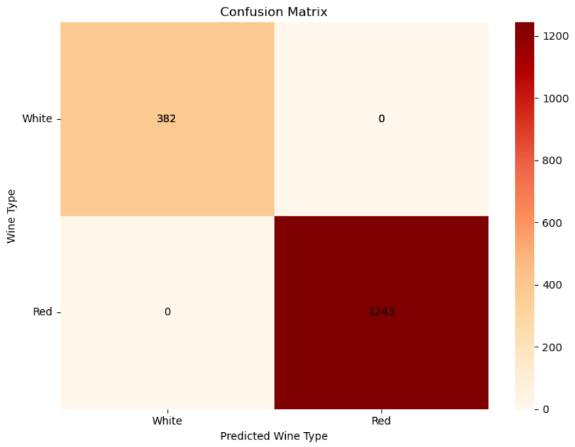
Red Or White
Spoiler Alert: The algorithm didn’t even need to taste the wine – just had to check the 'volatile acidity!'

Slide 9
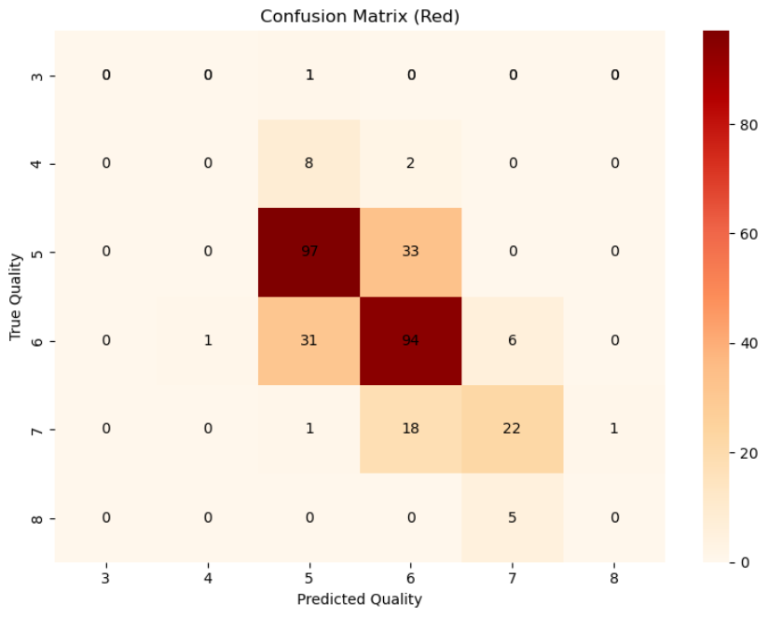
Red/White Wines Separately
RFM Model (Red and White Wines without Classification):
Red and white wines were analyzed separately using actual quality numbers (3-8) without classification.
Both models achieved accuracy between 62-67%.
Confusion matrix showed difficulty in predicting exact quality numbers, with predictions often close to the true value but not exact.

Slide 10

Red/White Wines Separately

Slide 11
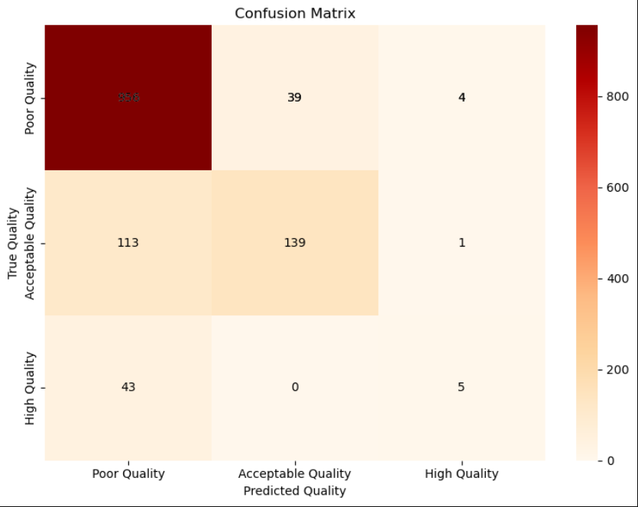
Results and Conclusions
RFM Model (Combined Dataset with Quality Class):
Achieved an accuracy of 82% in classifying wines into Poor, Acceptable, and High quality classes
.
The confusion matrix showed the majority of predictions fell within the correct quality class.

Slide 12

Questions???

Slide 13

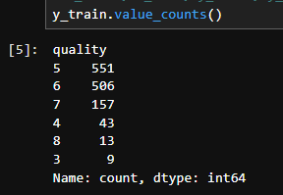
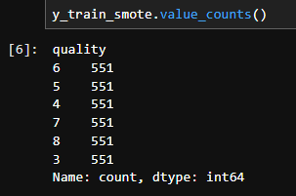
SMOTE ATTACK
You thought we didn’t balance the classes…
But BOOM! 💥 We hit you with SMOTE!
SMOTE (Synthetic Minority Over-sampling Technique) swooped in like a hero to save our model!
It generated synthetic samples to balance the low, medium, and high wine quality classes.
Now, our RFM model has seen the light – balanced, stronger, and ready for battle!
Original class distribution was heavily imbalanced. SMOTE brought justice by balancing it out.
Before SMOTE
After SMOTE

